Slide 1
Re-Gain Your Innovative Edge With Next Practices
Global Talent Strategy, Operations and
Communications – Setting the Stage Now
For 2013 and Beyond
Scott Hamilton
Executive Next Practices Institute

Slide 2
Executive Next Practices Institute
.

Slide 3
Next Practices
Ideas, processes, concepts and solutions that move us beyond the “status quo”.
Not “how are others doing it best” but rather, “where do we go from here that represents a true fundamental shift in value”…

Slide 4
2008-2012 Global Brand Turbulence
.
Notes:
Message given to c-level as well as hr
4

Slide 5
.
.

Slide 6
Who is the Red Digital in Your Industry?

Slide 7
Where is the largest opportunity for innovation within your company/industry?

Slide 8
.
.

Slide 9
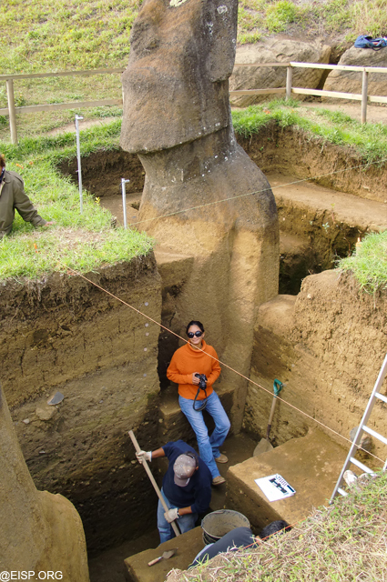

Slide 10
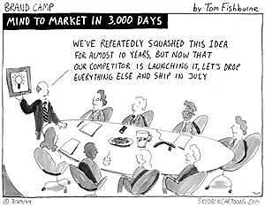

Slide 11
5 Key Steps to Next Practices
Craft a Winning Vision
Identify Internal Barriers- External Trends
Opportunities for Value Creation
Individual-Team Development
Develop, Test, Launch

Slide 12
1. Communicate the Vision- Inspire
.

Slide 13
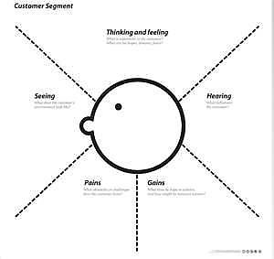
2. Market & Customer Trends
.

Slide 14
Breaking Internal Fear Barriers: Unleashing the Full Potential of Your Organization
Published by The Gallup Press, 2011

Slide 15
The Pyramid of Bureaucracy
Empire Building
Territorialism
Parochialism

Slide 16
3. Opportunities- Value Creation

Slide 17
Value Creation
Eliminate Which factors can you eliminate that your industry has long competed on? | Raise Which factors should be raised well above the industry’s standard?
Reduce Which factors should be reduced well below the industry’s standard? | Create Which factors should be created that the industry has never offered?

Slide 18
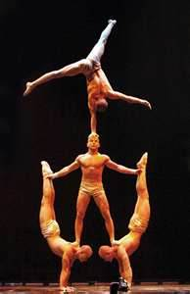
ELIMINATE Star Performers Animal shows Aisle concession sales Multiple show arenas
REDUCE (Family audience to targeted adult entertainment) Fun & Humor Thrill and Danger
Raise Unique Venue
Create Theme Refined environment Multiple productions Artistic Music and Dance

Slide 19
4. Individual & Team Approach

Slide 20
Global Workforce Engagement in Innovation- 2%

Slide 21
Confirm ROI/Profit

Slide 22
5. Develop, Launch, Test

Slide 23
How Will You Create a Culture of Innovation and Sense of Urgency?

Slide 24
Re-Gain Your Innovative Edge With Next Practices
THANK YOU
Scott Hamilton
Executive Next Practices Institute
www.enpinstitute.com

